Slide 1
Data 698 Final Project
Tony Mei

Slide 2
Company Bankruptcy Predictors
Objective: Identify which features contributes to the bankruptcy of a company
The Data: Data collected from the Taiwan Economic Journal for the Years 1999-2009
Source: https://www.kaggle.com/fedesoriano/company-bankruptcy-prediction
Size: 6819 samples
Features: 96 predictor variables, 1 response variable (Bankruptcy)
1- Bankrupt
0- Non Bankrupt

Slide 3
Approach
Data Exploration
Data Cleansing
Model Development
Logistic Regression
Support Vector Classifier
GBM
K Nearest Neighbors
Model Comparison

Slide 4
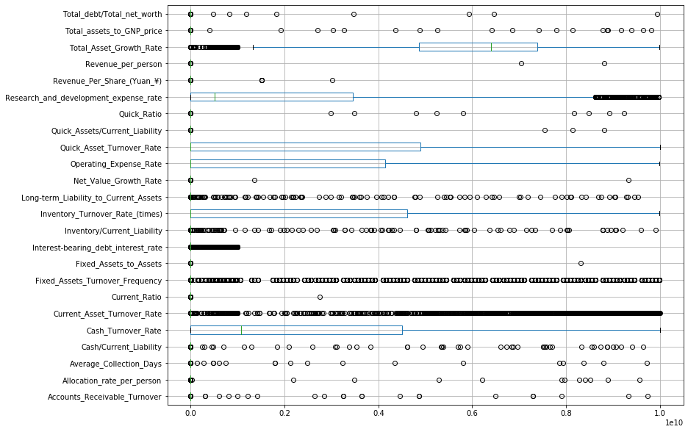
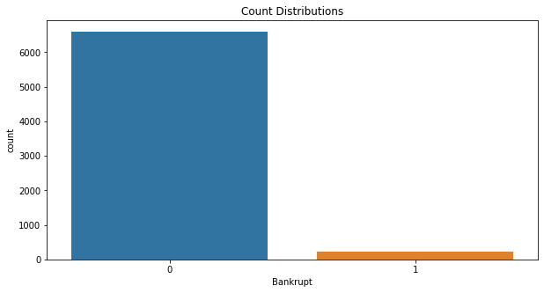
Exploratory Data Analysis
Imbalanced Dataset
Observing the Outliers

Slide 5
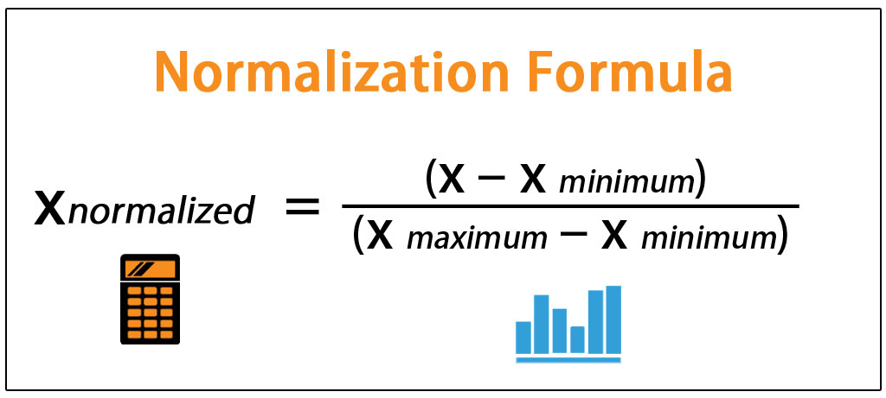
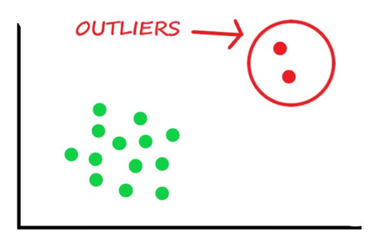
Data Cleansing
Min/Max Normalization
Capping Outliers

Slide 6
Multicollinearity
Used to check if there is perfect correlation between any of the columns. If the correlation is more than 0.95 or less than -0.95 then remove one of the columns to avoid multicollinearity in the dataset.
17 columns dropped

Slide 7
Balancing data with SMOTE
Imbalance dataset
SMOTE(Synthetic Minority Oversampling Technique) will be used which oversamples the minority class, the bankrupt counts in this case. It duplicates examples in the minority class, yet they won't add any new information to the models. The new examples can be synthesized from existing examples.

Slide 8
Logistic Regression
Logistic regression is a classification algorithm, used when the value of the target variable is categorical in nature. Logistic regression is most commonly used when the data in question has binary output, so when it belongs to one class or another, or is either a 0 or 1.
Important Features
Operating Profit Rate
Working Capital Turnover rate

Slide 9
Support Vector Classifiers
SVC is a supervised learning algorithm. This means that SVM trains on a set of labeled data. SVC studies the labeled training data and then classifies any new input data depending on what it learned in the training phase.
A main advantage of SVC is that it can be used for both classification and regression problems.
SVM can be used for classifying non-linear data by using the kernel method. The kernel method means transforming data into another dimension that has a clear dividing margin between classes of data. The kernels can be Linear, Radial, Polynomial or Sigmoid.
In this project to predict bankruptcy, radial basis function (rbf) are used.

Slide 10
Gradient Boosted Classifiers
Ensemble of weak decision tree learners -> prior trees inform improvement in subsequent trees -> strong predictive performance
Hyperparameter tuning (optimum per grid search) focused on
Number of trees (100)
Depth of trees (8)
Learning rate: (0.1)
Subsample: (0.85)

Slide 11
K Nearest Neighbors
The KNN algorithm assumes that similar things exist in close proximity. In other words, similar things are near to each other.
Used to solve both classification and regression problems.

Slide 12
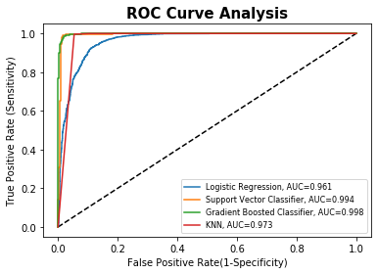
Model Comparison

Slide 13
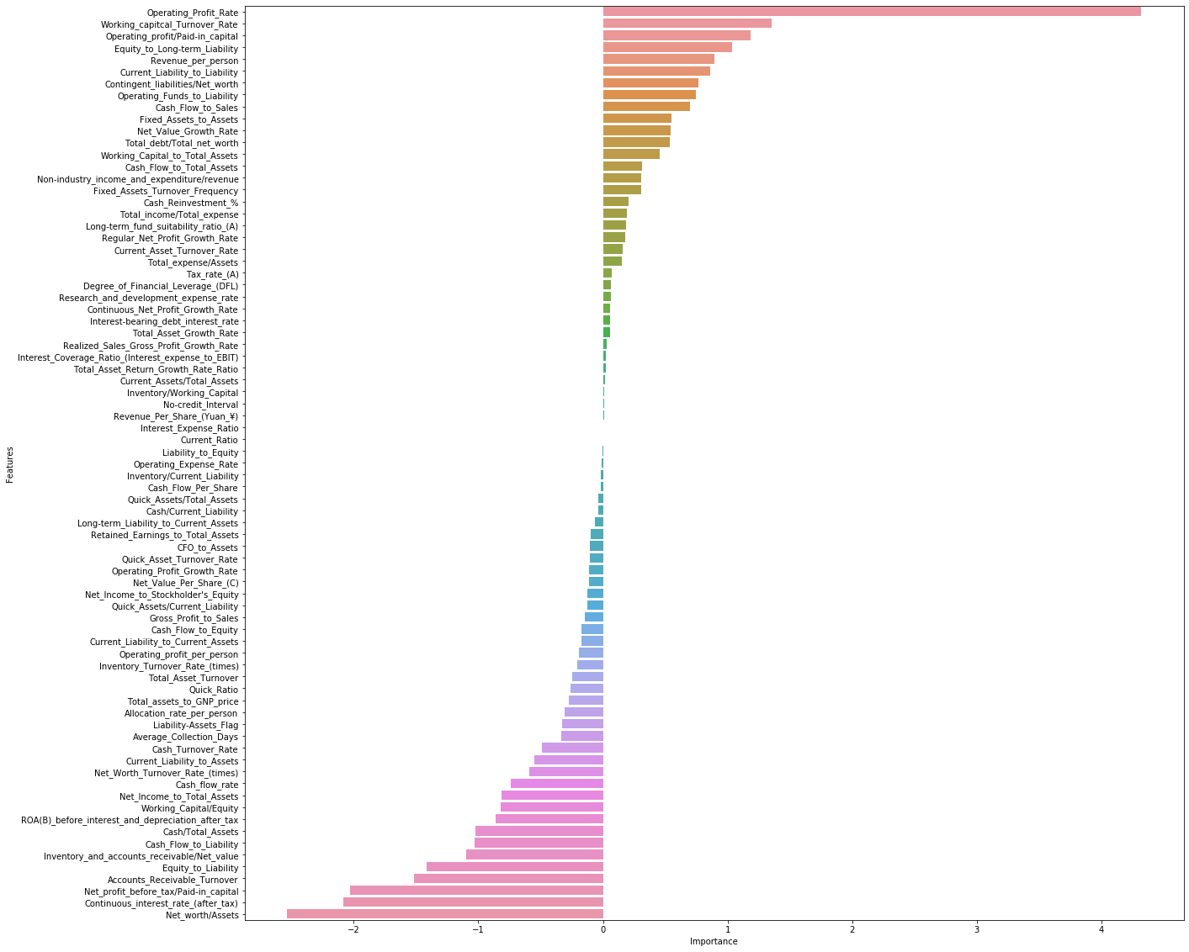
Model Comparison Importance features of LR

Slide 14
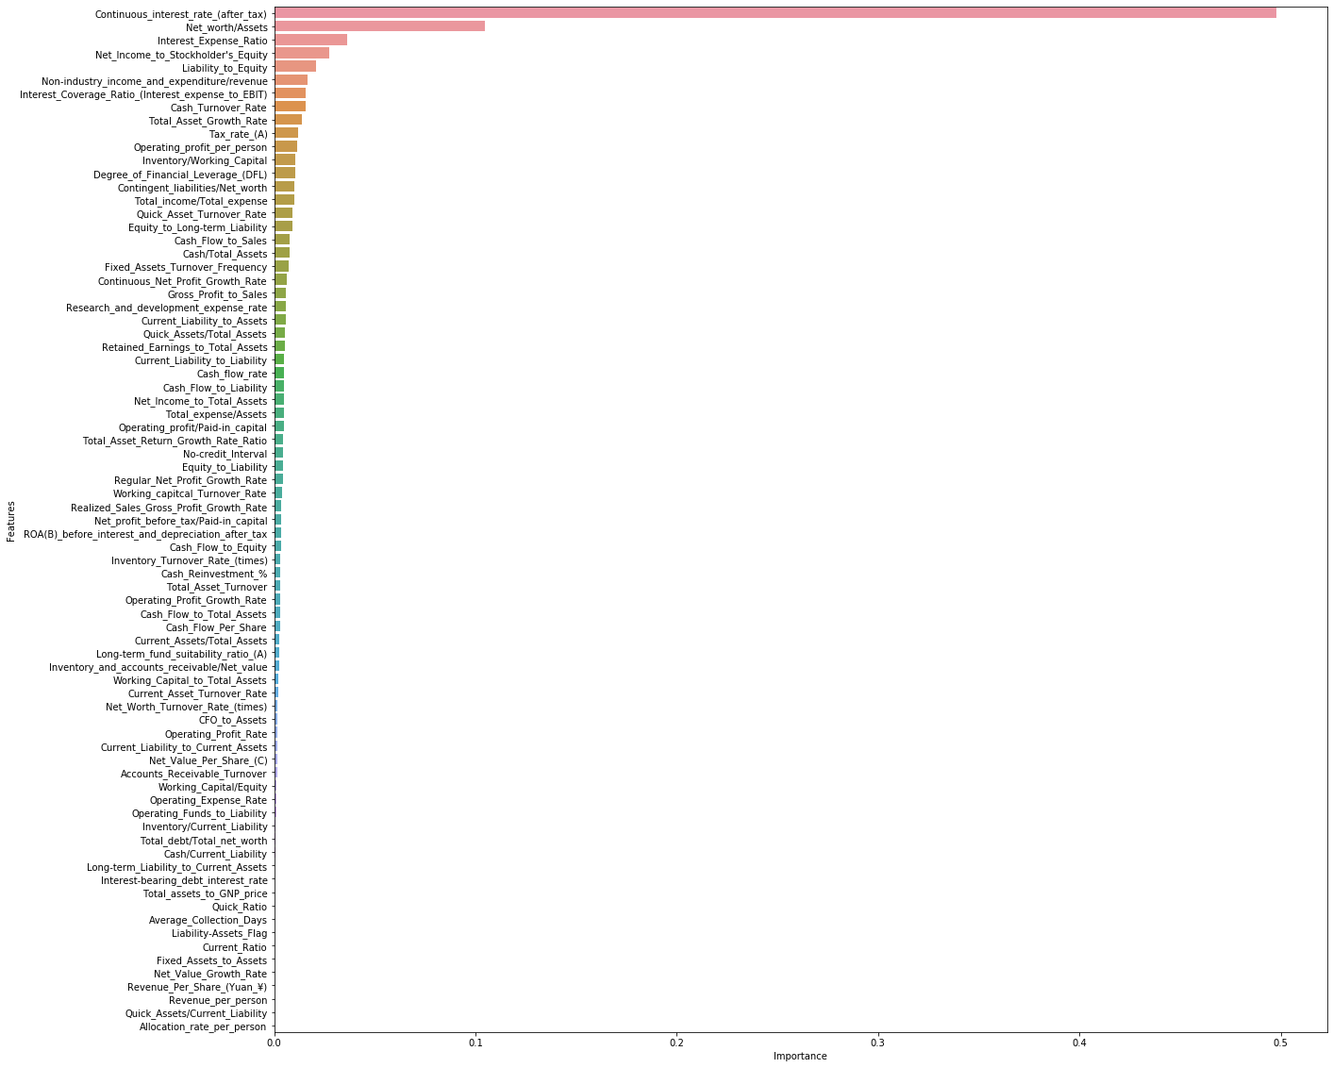
Model Comparison Importance Features of GBC

Slide 15
Model Comparison
Model | AUC | Accuracy | Recall of 0: Fin. Stable | Recall of 1: Fin. Unstable
Logistic Regression | 0.961 | 0.91 | 0.89 | 0.93
Support Vector Classifier | 0.994 | 0.98 | 0.96 | 1.00
Gradient Boosted Classifiers | 0.998 | 0.98 | 0.97 | 0.99
KNN | 0.973 | 0.94 | 0.87 | 1.00

Slide 16
Conclusions & Future Work
The GBC model has the best performance overall with 98% Accuracy, and 97% and 99% recall for 0 (Fin. Stable) and 1 ( Fin. Unstable)
All models perform relatively well when predicting 0 (Fin. Stable).
Logistic regression performs the worst out of all the models when predicting for 0 (Fin. Stable) and 1 ( Fin. Unstable)
Future work: modeling with Corporate Governance Indicators(CGI) alongside with financial ratios

